Slide 1

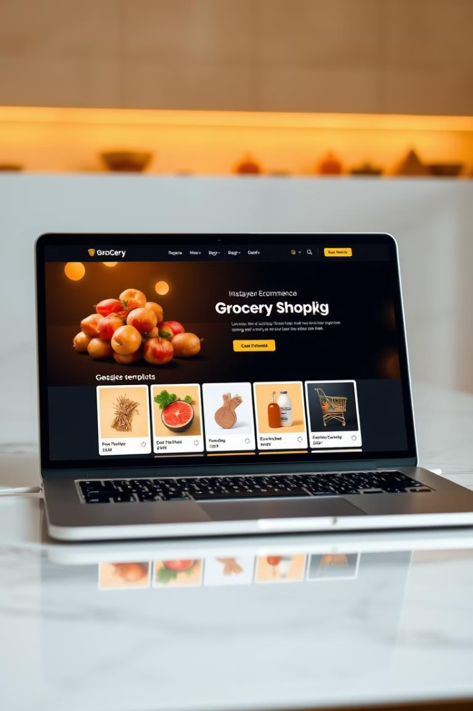
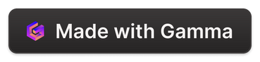
Grocery Web App using MERN Stack
BY
VENIYAN U [211521104176]
SNEGAN V [211521104151]
SIVAKUMAR R [211521104147]
SUJITH ANTONY F [211521104162]

Slide 2
Introduction to the MERN Stack
MongoDB
ExpressJS
ReactJS
NodeJS
A flexible, scalable NoSQL database for storing and managing grocery product data.
A fast and minimalist web application framework for Node.js, powering the backend API.
A modern, component-based library for building the responsive and interactive user interface.
The JavaScript runtime environment that enables server-side application development.

Slide 3
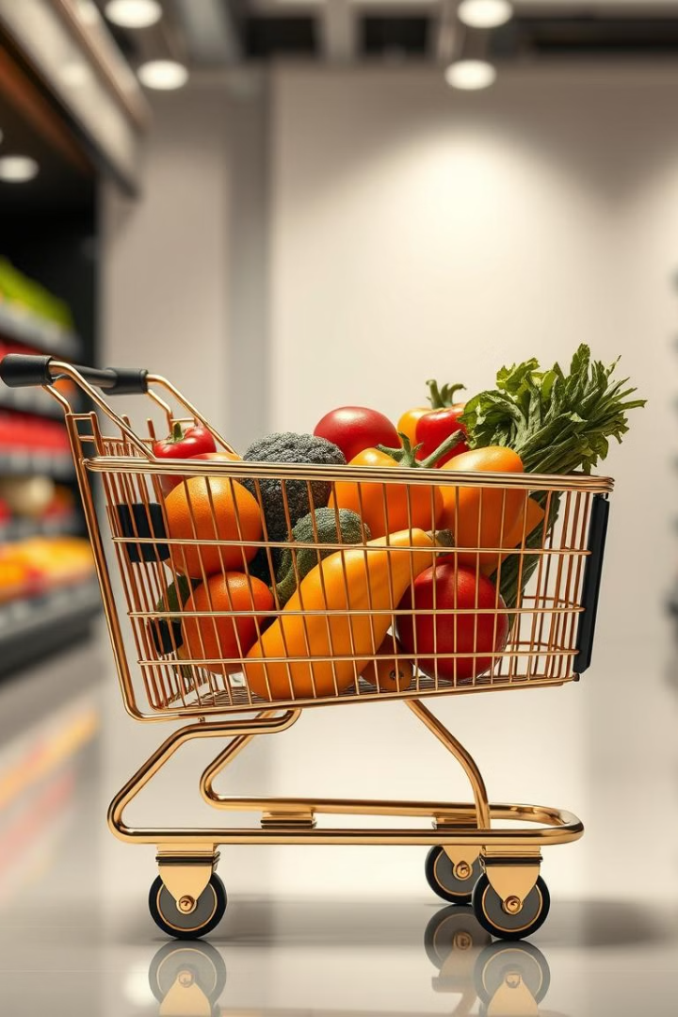
Key Features of the Grocery Web App
1
Product Catalog
2
Shopping Cart
Browse and search an extensive catalog of grocery items, with detailed product information and images.
Add items to the cart, view the total, and proceed to checkout with a seamless user experience.
3
Secure Checkout
Implement a secure payment gateway to accept credit card payments and manage orders.

Slide 4
Database Design and Management
Data Modeling
CRUD Operations
Performance Optimization
Design a schema to represent grocery products, categories, orders, and user information in MongoDB.
Implement Create, Read, Update, and Delete operations to manage data in the database.
Ensure efficient data retrieval and handling through indexing, pagination, and caching strategies.

Slide 5
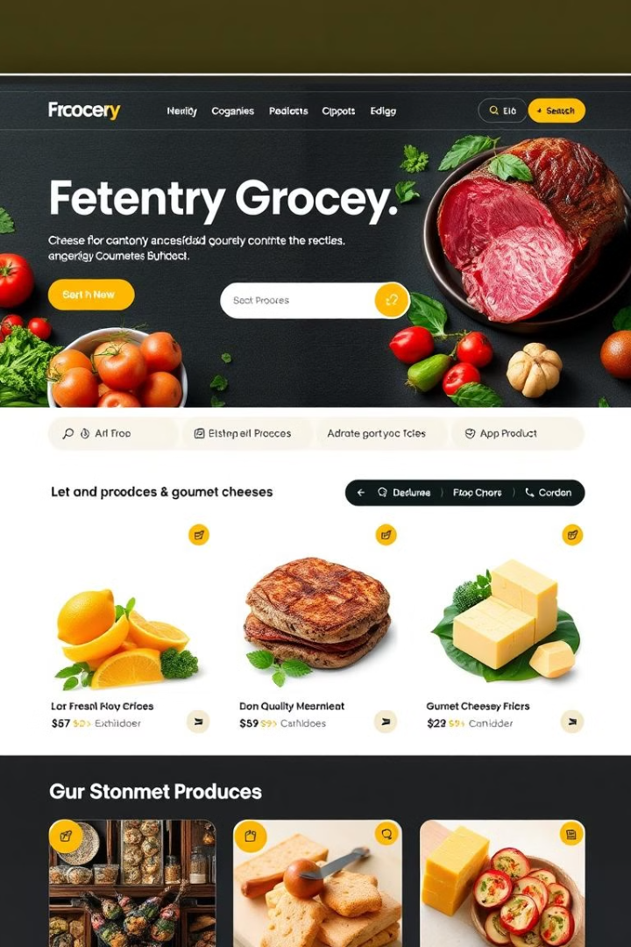
Building the Front-end with React
React Components
State Management
Leverage React's component-based architecture to build modular and reusable UI elements.
Utilize state management libraries like Redux or Context API to manage the application's state efficiently.
Routing and Navigation
Implement client-side routing with React Router to enable seamless navigation and user experience.

Slide 6

Implementing the Back-end with Node.js and Express
API Design
1
Define RESTful APIs for handling CRUD operations, authentication, and payment processing.
2
Authentication and Authorization
Implement secure user authentication and role-based access control for the application.
Error Handling and Logging
3
Establish robust error handling and logging mechanisms to ensure a reliable and maintainable backend.

Slide 7
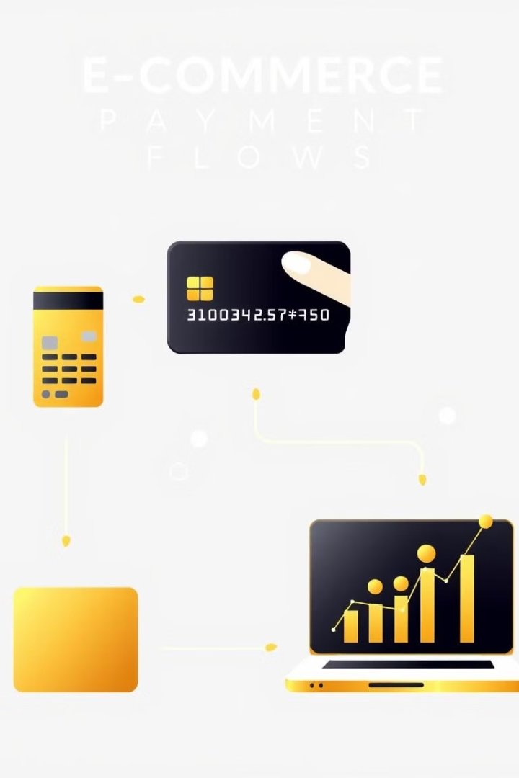



Integrating Payment Processing
Secure Payments
Integrate a popular payment gateway like Stripe or PayPal to handle secure online transactions.
Order Fulfillment
Manage the order lifecycle, from placement to shipping, using the payment gateway's order management tools.
Analytics and Reporting
Leverage the payment gateway's reporting and analytics features to gain insights into sales and customer behavior.

Slide 8
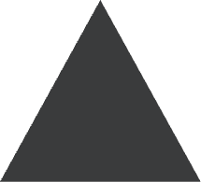



Deployment and Ongoing Maintenance
Cloud Hosting
1
Deploy the MERN stack application on a cloud platform like AWS, Azure, or Google Cloud.
2
Continuous Integration
Implement CI/CD pipelines to automate the build, test, and deployment processes.
Monitoring and Logging
3
Set up monitoring and logging solutions to track application performance and identify issues.
Scalability and Maintenance
4
Ensure the application can handle increased traffic and regularly maintain and update the codebase.

Slide 9
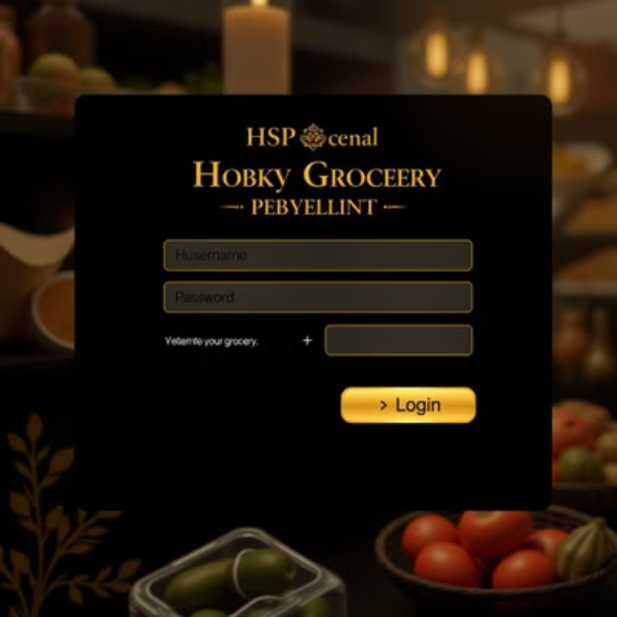
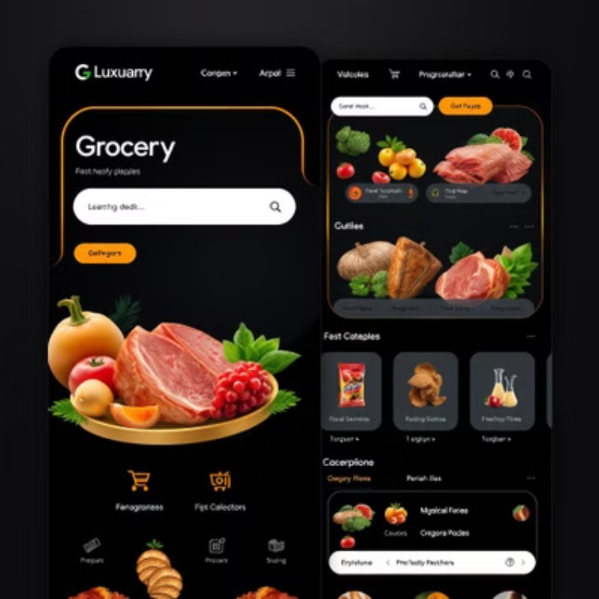

Slide 10
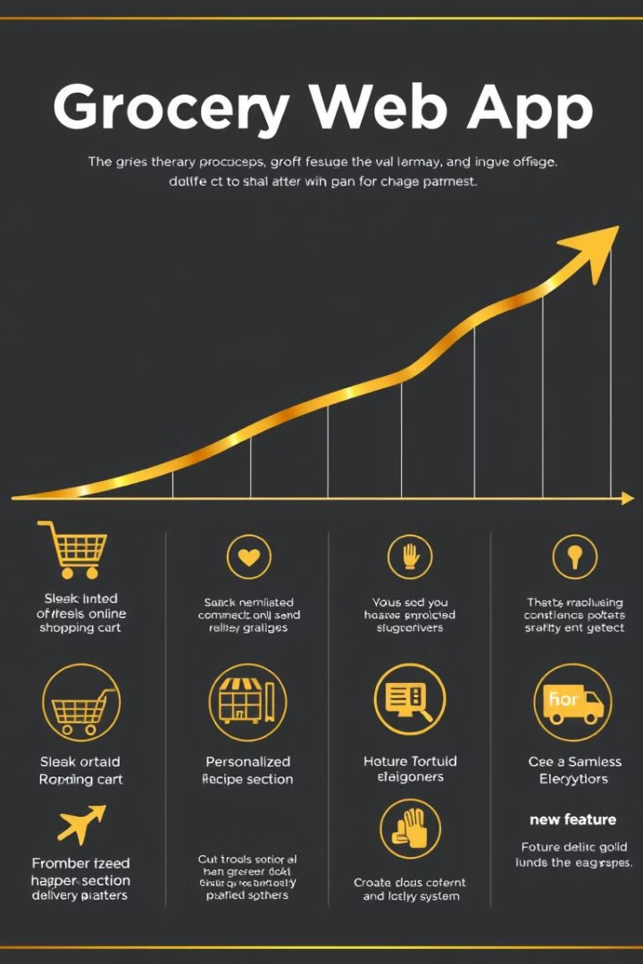
Conclusion and Future Enhancements
$1M
Projected Revenue
The grocery web app has the potential to generate $1 million in annual revenue by the end of the first year.
25%
Conversion Rate
With the implemented features, the web app is expected to achieve a 25% conversion rate from visitors to customers.
95%
Customer Satisfaction
The grocery web app aims to deliver a seamless and satisfying shopping experience, with a 95% customer satisfaction rate.

Slide 11




